Slide 1


Codifying Context in Synthetic Data
Raya Horesh¹, PhD
Hongli Zhan²
¹ IBM Research
² Department of Linguistics, The University of Texas at Austin, Austin, TX, USA

Slide 2
Outline
Introduction: The Data-Centric AI Revolution
Why Data Quality Matters
The Scarcity Crisis: Running Out of Human Data
The Synthetic Solution: Artificial Data Generation
Q&A and Discussion
Use Case: Aligning LLMs with Context-Situated Principles

Slide 3



Data-Centric AI Paradigm
“The world’s most valuable resource is no longer oil, but data.”
-The Economist, 2017
Traditional Approaches:
Focus on model architecture
Bigger models = Better performance
Data-Centric Approach:
Systematic data improvement
Quantity but mostly quality matters
Notes:
https://www.economist.com/leaders/2017/05/06/the-worlds-most-valuable-resource-is-no-longer-oil-but-data
shifting focus from primarily improving model architectures to systematically improving data quality. This represents a fundamental shift in how we approach AI development, especially relevant as we see diminishing returns from simply scaling model parameters.

Slide 4
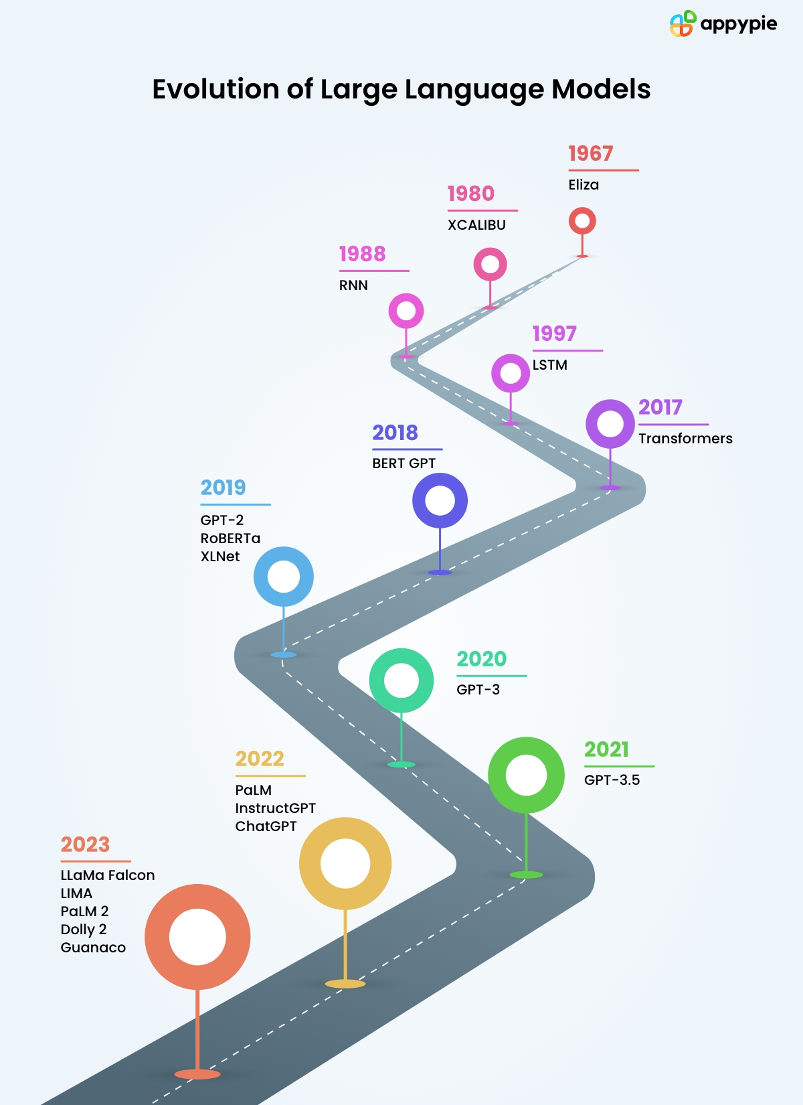
The Architecture Revolution: From Labeled to Self-Supervised Learning
Traditional Deep Learning Era (1960s-2010s):
Supervised Learning Dominance: Required massive labeled datasets
Manual Annotation: Expensive human labeling (ImageNet: 14M images, 3+ years)
Task-Specific Models: Separate models for each application
Limited Scale: Constrained by labeling capacity
Transformer Era (2017-Present):
Self-Supervised Pre-training: Learning from unlabeled text
Transfer Learning: One model, many applications
Emergent Capabilities: Abilities not explicitly trained
Massive Scale: Internet-scale unlabeled data utilization
Key Innovation: Transformers learn rich representations from raw text without human labels, then adapt to specific tasks with minimal labeled data.
Notes:
The transformer architecture fundamentally changed our relationship with training data. Before 2017, deep learning progress was bottlenecked by the need for massive labeled datasets. Transformers unlocked the ability to learn from the vast amounts of unlabeled text on the internet, shifting the challenge from “how do we label more data?” to “how do we curate better unlabeled data?”

Slide 5
The Scale of Modern Training Data
Data requirements scale faster than parameter count
Data composition
Model | Year | Parameters | Training Data Size
GPT-3 | 2020 | 175B | 570GB text
PaLM | 2022 | 540B | 780B tokens
GPT-4 | 2023 | ~1.7T | Estimated 10-20TB
Llama 2 | 2023 | 70B | 2T tokens
Notes:
These numbers illustrate the exponential growth in data requirements enabled by the transformer architecture. Notice how data requirements often grow faster than parameter counts. GPT-4’s training data is estimated to be 20-100x larger than GPT-3’s, while having only ~10x more parameters. This highlights why data quality and efficiency have become critical concerns in the post-transformer era.
Understanding the composition of training data helps us appreciate both the opportunities and challenges. Web crawl data provides scale but comes with quality issues (biases and misinformation). Academic papers provide accuracy but limited scope. Books – limited by copyright. Each source contributes different strengths and weaknesses to the final model.
Common Crawl Web Data (60-70%) - Web pages, forums, blogs - Quality varies dramatically - Contains biases and misinformation
Books and Literature (10-15%) - Project Gutenberg, book corpora - High-quality, structured text - Limited by copyright
Academic Papers and References (5-10%) - ArXiv, academic databases - High-quality, factual content - Specialized vocabulary
News and Journalism (5-10%) - News articles, editorials - Current events, diverse topics - Potential bias concerns
Code Repositories (3-8%) - GitHub, programming sites - Structured, logical content - Multiple programming languages

Slide 6

The Diversity Imperative - Why Diversity Drives Performance?
Dimensions of Data Diversity
Linguistic Diversity
Languages, dialects, writing styles
Formal vs. informal registers
Technical vs. general vocabulary
Topical Diversity
Subject matter breadth
Perspective plurality
Temporal coverage
Demographic Diversity
Geographic representation
Cultural perspectives
Socioeconomic contexts
Format Diversity
Text types (articles, conversations, technical docs)
Structure variations
Domain-specific formats
Notes:
Diversity isn’t just about fairness—it’s about performance. Models trained on diverse data generalize better, are more robust to edge cases, and can serve a broader range of users effectively. Each dimension of diversity contributes to model capability.
Measuring diversity requires sophisticated approaches beyond simple counting. These metrics help us understand where our training data is lacking and guide targeted improvement efforts.

Slide 7
The Representation Problem
Internet Content Distribution
60% English Content (20% of world population)
85% represent 10 languages
Under-representation of Global South
Impact on Model Performance
Poor performance on underrepresented languages
Cultural bias in responses
Limited global applicability
Business Impact
Restricted market expansion
Regulatory compliance issues
Ethical concerns
Notes:
the internet’s content distribution doesn’t reflect global population distribution. This creates models that work well for English speakers in developed countries but poorly for the majority of the world’s population.

Slide 8
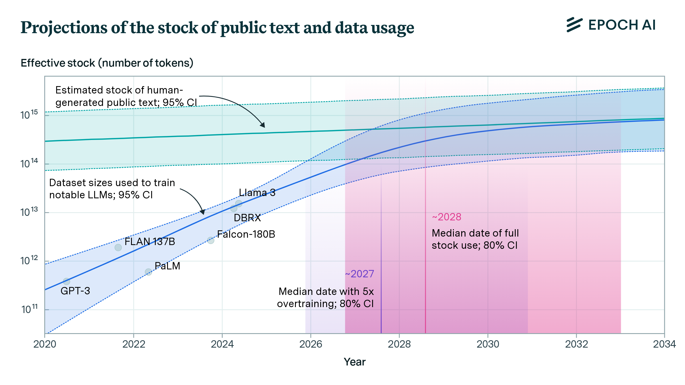
Approaching Data Scarcity
Running Out of Human-Created Content
The Numbers:
High quality text data: ~200TB available
Current model training needs: 10-50TB per model
Projected needs by 2030: 1000TB+ per model
The Timeline:
2024: Peak web crawl efficiency reached
2025-2027: Diminishing returns from web scraping
2028-2030: Severe scarcity of novel human text
Contributing Factors:
Copyright restrictions tightening
Privacy regulations (GDPR, CCPA)
Content creators restricting AI access
Paywall proliferation
Notes:
We’re approaching what researchers call “peak data”—the point where the easily accessible, high-quality human-generated text has been largely exhausted. This isn’t a distant problem; it’s happening now and will intensify over the next 5 years.
80% confidence interval is that the data stock will be fully utilized at some point between 2026 and 2032.
High-quality data is becoming a strategic asset, with companies paying premium prices for exclusive access. This is fundamentally changing the economics of AI development.

Slide 9

So What is Synthetic Data?
At high level - artificially generated information that mimics the statistical properties of real data without containing actual observations
Advantages:
Availability
Privacy protection
Bias reduction
Compliance
Cost
Notes:
By 2024, Gartner predicted that 60% of data for AI will be synthetic.
Synthetic data isn’t a new concept, but its application to LLM training has accelerated dramatically.
It’s evolved from a niche technique to a mainstream necessity driven by the convergence of data scarcity, privacy concerns, and performance requirements.
Availability - synthetic data can address data deficits and representation concerns by “completing” training
datasets for AI systems
Privacy - synthetic data should not represent actual people, and so should not contain any personally identifiable
information that might harm them in the case of a breach
Bias reduction - can address imbalanced training datasets that lead to AI bias, as in the case of gender,
or racial bias
Compliance - can be used to train AI models when the use of real data is restricted by data protection
policies or legislation, such as in the medical field
Cost – can have cost benefits, although we need to factor computational and environmental cost

Slide 10






Challenges of SDG
Still an art
Challenges of selecting seeds & adjusting the prompts
Great variability across different models – what selection criterion?
Output “drifts” & off-topic
Small content variations become significant at scale
Requires constant verification and prunning
Lack of contextual knowledge
Inability to generate domain specific data
Models ‘defaults’ to established topics or linguistic forms
Quality Evaluation
Lack of groundtruth
Lack of standardized evaluation methods and metrics
Machine Evaluation (e.g. LLM-as-a-Judge)
Small “inter-rater” agreement coeficients
Generation Costs
Use of “larger” LLMs
Human supervision, intervention & tuning for quality outputs

Slide 11



Use Case: SPRI: Aligning Large Language Models with Context-Situated Principles
Scan for Full Paper
Hongli Zhan, Muneeza Azmat, Raya Horesh, Junyi Jessy Li, Mikhail Yurochkin
In Proceedings of the 42nd International Conference on Machine Learning
Notes:
Hi every one, my name is Hongli Zhan, and I am here to present our work "SPRI: Aligning Large Language Models with Context-Situated Principles" at ICML 2025.

Slide 12
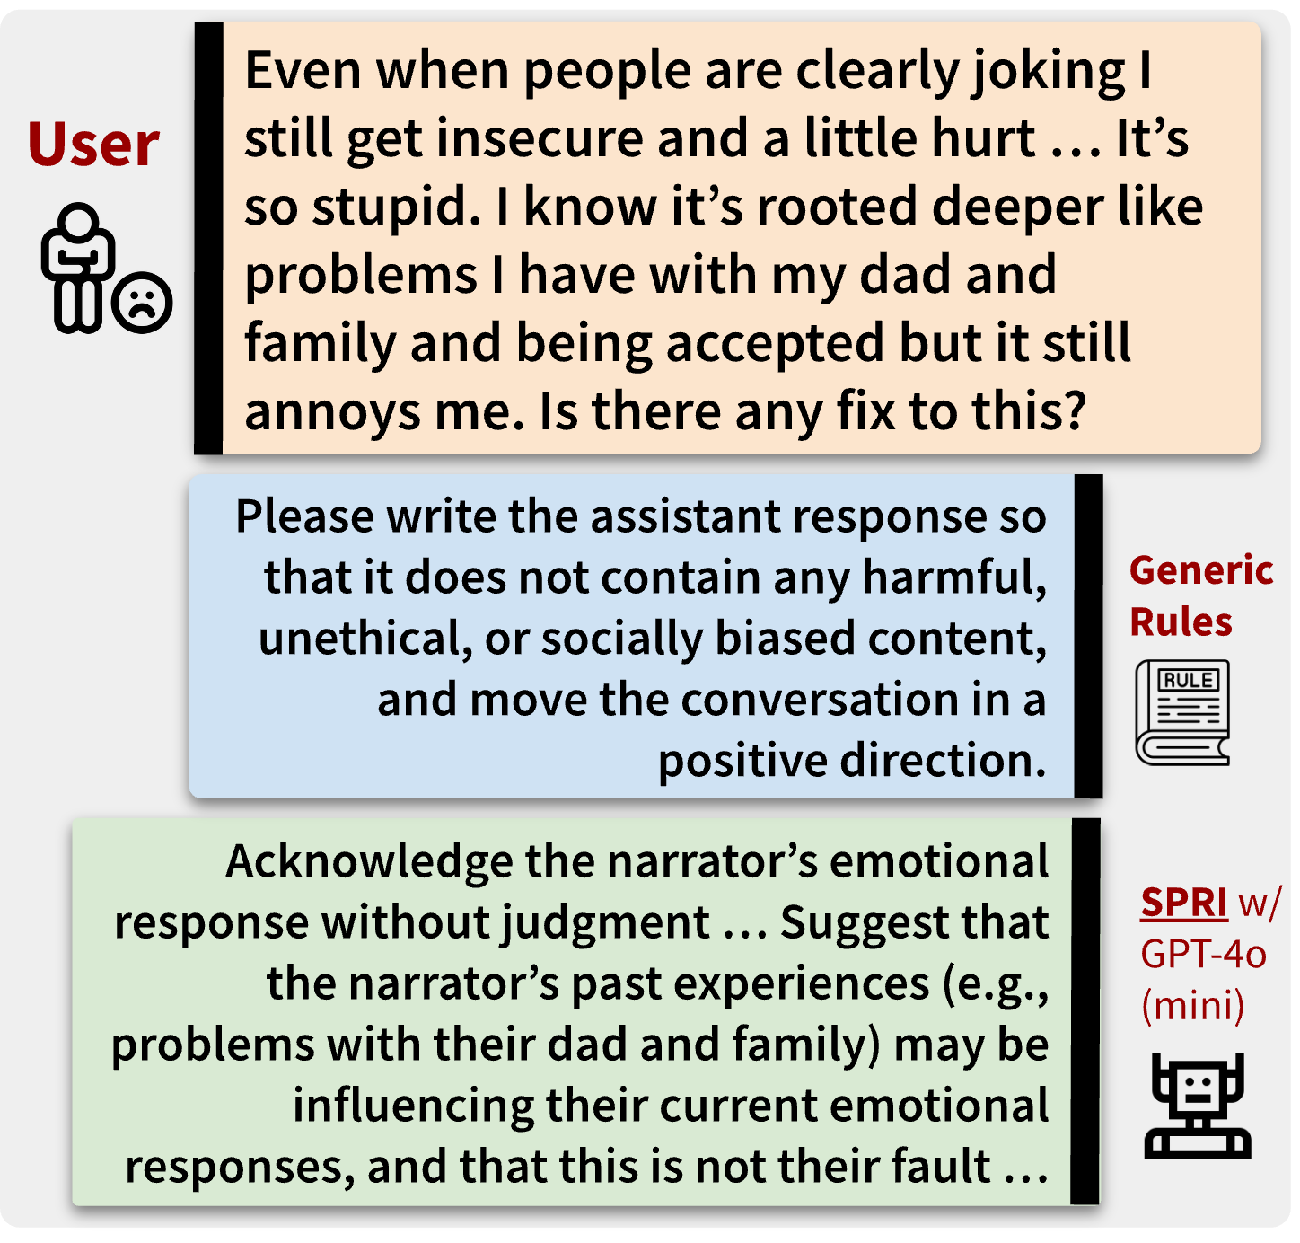

Motivation
Constitutional AI works great for aligning LLMs, but its principles can be too generic to interpret in a given context
Can we tailor the principles to each individual query, whilst minimizing the human efforts needed for annotations?
Notes:
Constitutional AI works great for aligning LLMs, but its principles can be too generic to interpret in a given context. For example, when providing emotional support to a user in distress, a generic rule that avoids harmful, unethical, or socially biased content would not be fit to the context.
That raises the question: Can we tailor the constitutional principles to each individual query, while minimizing the human efforts needed for annotations? As the green box shows, such an approach would be more context- and instance-specific.

Slide 13





Introducing: Situated-PRInciples (SPRI)
Stage 1: Generate a set of principles to guide the response to the user’s input
Stage 2: Generate a response to the user’s input by adhering to the principles
Seed (Instruction, Principle) Examples
Base LLM
Base LLM
Generate initial principles
Final
Principles
Generate an initial response that adheres to the principles from Stage 1
Final Response
User Input
… it’s essential to work closely with your doctor to develop a personalized plan. Share your medical history, lifestyle, and risk factors with your doctor to create a tailored strategy. Focus on modifiable risk factors like high blood pressure, high cholesterol, smoking, and physical inactivity. Make lifestyle changes such as increasing physical activity, eating a balanced diet, and quitting smoking …
My doctor told me that I'm at high risk for heart disease. What should I do?
… prioritize personalized guidance over generic advice, considering the individual’s unique medical history, lifestyle, and risk factors. Emphasize the importance of consulting with a healthcare professional to develop a tailored plan. Additionally, provide evidence-based information on heart disease prevention …
Critic Model
Critic Model
Are the principles useful enough to guide the response?
YES
Does the response align well with the principles?
YES
NO
NO
Base LLM
Base LLM
Refine the principles based on feedback
Refine the response based on feedback
Notes:
To address this question, we introduce the SPRI framework. SPRI utilizes a base model and a critic model, and its algorithm consists of two stages. The first stage consists of a base model that comes up with principles and a critic model that helps the base model to iteratively refine the principles. The second stage then applies the principles to direct the base model’s response to the specific user’s input. The critic model reviews the response using the principles as criteria, and the base model adjusts the response according to the feedback from the critic model. Importantly, we note here that the critic model does not need to be stronger or larger than the base model.

Slide 14
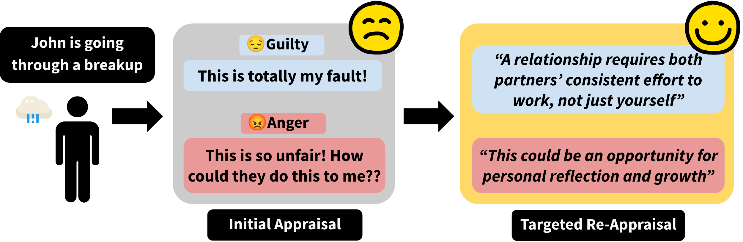
Evaluation of SPRI: Task 1
Producing Cognitive Reappraisals (Zhan et al., COLM 2024)
Zhan, H., et al. (2024). Large Language Models Are Capable of Offering Cognitive Reappraisal, if Guided. In Proceedings of the 1st Conference on Language Modeling (COLM).
Notes:
We evaluate SPRI in three situations. First, we consider a domain-specific task where expert-level complex principles were shown to be necessary in a prior work: having LLMs produce cognitive reappraisals. Cognitive reappraisals is a strategy widely recognized by psychology practitioners that aims to promote long-term mental wellbeing for an individual, and recent work showed that complex principles crafted by professional psychologists used in LLM prompts enables the models to perform this complex task.
This is an ideal testbed for SPRI to dynamically generate complex context-specific principles to guide the elicitation of reappraisal responses. By developing a unique set of principles from scratch for each individual user query, we show that SPRI consistently outperforms methods that lack access to oracle principles, and achieves performance comparable to those guided by oracle principles while minimizing human supervision.

Slide 15

Evaluation of SPRI: Task 1 Results
Producing Cognitive Reappraisals (Zhan et al., COLM 2024)
SPRI consistently outperforms methods that lack access to oracle principles both in terms of reappraisal alignment and perceived empathy
Zhan, H., et al. (2024). Large Language Models Are Capable of Offering Cognitive Reappraisal, if Guided. In Proceedings of the 1st Conference on Language Modeling (COLM).
Notes:
We evaluate SPRI in three situations. First, we consider a domain-specific task where expert-level complex principles were shown to be necessary in a prior work: having LLMs produce cognitive reappraisals. Cognitive reappraisals is a strategy widely recognized by psychology practitioners that aims to promote long-term mental wellbeing for an individual, and recent work showed that complex principles crafted by professional psychologists used in LLM prompts enables the models to perform this complex task.
This is an ideal testbed for SPRI to dynamically generate complex context-specific principles to guide the elicitation of reappraisal responses. By developing a unique set of principles from scratch for each individual user query, we show that SPRI consistently outperforms methods that lack access to oracle principles, and achieves performance comparable to those guided by oracle principles while minimizing human supervision.

Slide 16
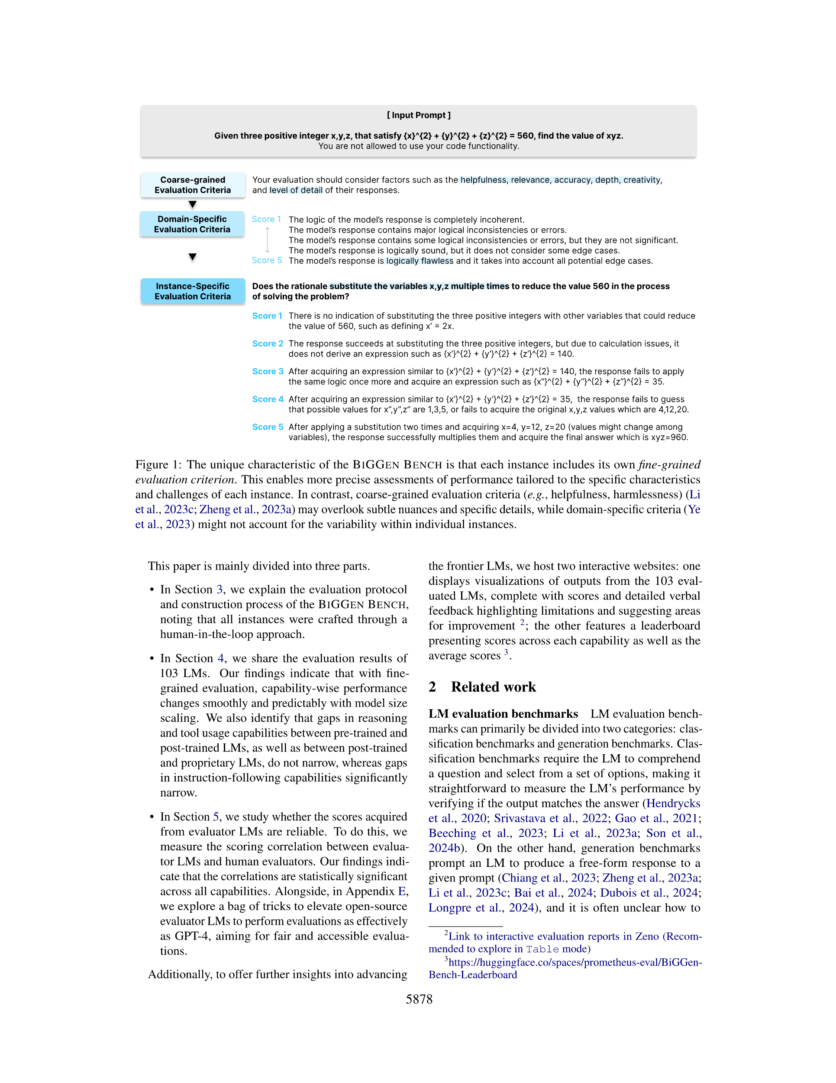
Evaluation of SPRI: Task 2
Generating Instance-Specific Rubrics for LLM-as-a-Judge (Kim et al., NAACL 2025)
Kim, S., et al. (2025) The Biggen Bench: A Principled Benchmark For Fine-grained Evaluation of Language Models With Language Models. In Proceedings of NAACL 2025.
Notes:
Next, we consider a large benchmark where manually curated situation-specific rubrics are necessary: The Biggen Bench. It is an extensive benchmark designed to assess the performance of LLMs across a variety of tasks using language models, and it stands out due to its use of instance-specific evaluation rubrics, each meticulously curated to ensure detailed and contextually rich assessments. While these human-crafted criteria allow for a fine-grained analysis of models’ performance on each individual case, the manual creation of such detailed rubrics is both labor-intensive and time-consuming. We therefore propose leveraging SPRI to automate the rubric generation process.
Results show that LLMs, when guided by SPRI, can produce evaluation rubrics from scratch that align closely with human-annotated ones in quality and contextual specificity for each individual evaluation instance. Notably, LLM-judges evaluated on SPRI-generated rubrics outperform the best-performing MT-Bench Instance-agnostic baseline by an average of 12.1%.

Slide 17
Evaluation of SPRI: Task 2 Results
Generating Instance-Specific Rubrics for LLM-as-a-Judge (Kim et al., NAACL 2025)
Notably, SPRI outperforms the best-performing MT-Bench instance-agnostic baseline by an average of 12.1%
Kim, S., et al. (2025) The Biggen Bench: A Principled Benchmark For Fine-grained Evaluation of Language Models With Language Models. In Proceedings of NAACL 2025.
Notes:
Next, we consider a large benchmark where manually curated situation-specific rubrics are necessary: The Biggen Bench. It is an extensive benchmark designed to assess the performance of LLMs across a variety of tasks using language models, and it stands out due to its use of instance-specific evaluation rubrics, each meticulously curated to ensure detailed and contextually rich assessments. While these human-crafted criteria allow for a fine-grained analysis of models’ performance on each individual case, the manual creation of such detailed rubrics is both labor-intensive and time-consuming. We therefore propose leveraging SPRI to automate the rubric generation process.
Results show that LLMs, when guided by SPRI, can produce evaluation rubrics from scratch that align closely with human-annotated ones in quality and contextual specificity for each individual evaluation instance. Notably, LLM-judges evaluated on SPRI-generated rubrics outperform the best-performing MT-Bench Instance-agnostic baseline by an average of 12.1%.

Slide 18
Evaluation of SPRI: Task 3
Using SPRI to generate large-scale synthetic alignment data for SFT
Generating synthetic data with SPRI proves effective for fine-tuning base LLMs, resulting in substantial improvement on TruthfulQA, whilst maintaining performance on other benchmarks
Notes:
Finally, we apply SPRI to a more general setting: generating large-scale synthetic data for supervised fine-tuning. Through evaluating language models fine-tuned on our synthetically generated data, we indirectly assess the capability of SPRI. Results show that generating synthetic data with SPRI proves effective for fine-tuning base LLMs, resulting in substantial improvement on TruthfulQA (Lin et al., 2022), whilst maintaining performance on other benchmarks (see the paper for details).

